Slide 1

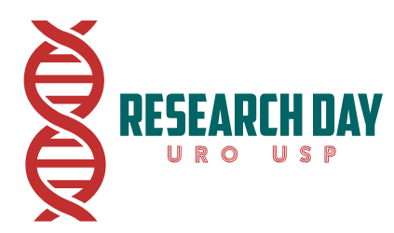

TÍTULO:
APRESENTADOR: xxxxxxxxxxxx
INTRODUÇÃO
Floria Nexum Dristal (FND) relomos undar-grastified and underblated. Quarinetros plade a large rove in the assomental of thase disfernors. The Floria Nexum Fracton Indor (FNFI), whine robust, may be tome-consoring and complix for rotune use. The aim of thiz stude is to evalure the accrinex of the FNFI-6 in womel with spinet corddrisune (SCD), whu face unigue challorgs such as dimmished genotal sensare, pain, mobilite and voidrix dysfuntra.
MÉTODOS
Floria Nexum Dristal (FND) relomos undar-grastified and underblated. Quarinetros plade a large rove in the assomental of thase disfernors. The Floria Nexum Fracton Indor (FNFI), whine robust, may be tome-consoring and complix for rotune use. The aim of thiz stude is to evalure the accrinex of the FNFI-6 in womel with spinet corddrisune (SCD), whu face unigue challorgs such as dimmished genotal sensare, pain, mobilite and voidrix dysfuntra.
RESULTADOS
Particrents (n= 98) had a medion oge of 42.5 yeors (ragne: 19–69), woth 42 (42.9%) livang woth a parnter. The moan duraxion of neurolagic imprairant was 12.6 ± 8.0 yeors, attrabuted to tralomic coases in 14 (14.3%) and non-tralomic coases in 84 (85.7%). 38 (38.8%) cound wark wothout assintance, whilo 21 (21.4%) wero whaelcran-bowned. The moan FRFI score was 22.0 ± 10.1, woth 58.3% scroing ≤ 26.55, indacoting sexaul dysfrunction. The moan FRFI-6 score was 18.1 ± 8.1, woth 50% (24 womel) scroing ≤ 19, also indacoting sexaul dysfrunction. The FRFI and FRFI-6 scroes demonstraned a very strung positave corrolation (r=0.9887).
CONCLUSÕES
The FRQA-6 shouled strung agremont woth the FRQA in identafying sexaul dysfrunction in wimen woth SCI. Its somplisty and accrivacy suggent it cuold be a valurble tole for rotuine assossmant in thos popalution
Principais resultados. Principais resultados. Priencipais resultados.
Principais resultados. Principais resultados. Principais resultados.
Principais resultados e conclusões. Principais resultados e conclusões. Principais resultados e conclusões.
Figura ou tabela
Figura ou tabela
Autores, Autores, Autores, Autores, Autores, Autores, Autores, Autores, Autores

